Slide 1

Salvatore DiLeo & Louis Sanchez ~present~
for the iPhone

Slide 2
KenKen is a logic and arithmetic based puzzle game. An average board size consists of 16 squares arranged in a 4x4 grid. Each square is filled with a number, from 1 to 4, abiding by a few simple rules:
The numbers cannot repeat in any row or column.
The numbers in each heavily outlined set of squares (cages) must combine (in any order) using the mathematical operation indicated to form the target number shown in the top corner of the cage.
Cages with one box are just filled with the target number.
A number can repeat within a cage as long as it is not in the same row or column.

Slide 3
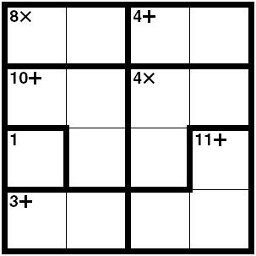
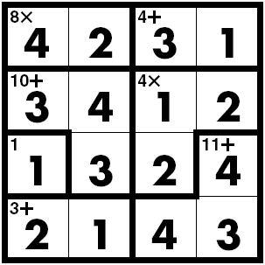
Example Board
Blank
Solved

Slide 4
Intended Audience:
Anyone who enjoys puzzles or logic-based games.
Technical Challenges and Resources Needed:
The main challenges will be to create a random board generator that creates sensible boards, to enable the user to save his current board for completion later, and to have the cages, target number, and indicated mathematical operation display properly no matter what random board is generated.
Overall Logic:
The grid of numbers would be created first, with the cages and their associated mathematical operations created after. Each individual number belongs to a specific cage, which in turn belongs to the board as a whole.
Member Responsibilities:
We will both work on all components of the project together, pair programming if you will, so there are no split responsibilities.

Slide 5
By Tuesday, 04 May, we plan to have the following implemented:
A random board generator, creating sensible (i.e. not impossible, not trivial) boards.
The ability to save the current board for completion later.
A notification system that warns the user if he places a number in an impossible position (e.g., placing a number in the same row or column a second time).
A clean, simple, and pleasing user interface.

Slide 6


Mock-Ups of the Major Screens
KenKen
KenKen
New Game
Load Game
By: Salvatore DiLeo &
Louis Sanchez
Save Game
Solve It

Slide 7
iPhone Functionality
iPhone capabilities enable…
Selecting table cells on the screen and editing its contents via touch.
Incrementing/decrementing numbers by sliding fingers anywhere across the screen.
Shaking the iPhone to clear the board.

Slide 8
Possible Future Developments
Thank You for Your Time!
Please comment or ask questions!
Different board sizes (e.g., 3x3, 4x4, 5x5, 6x6, 7x7, 8x8, or 9x9).
The ability to save multiple boards at once.
Displaying a timer for the user, including automatically saving his best times.

